Slide 1


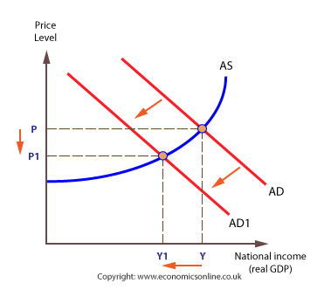
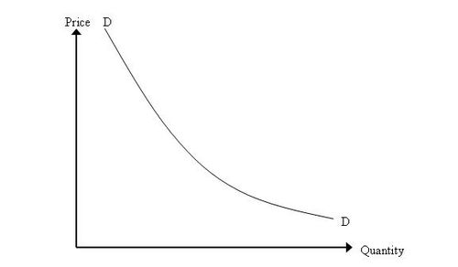
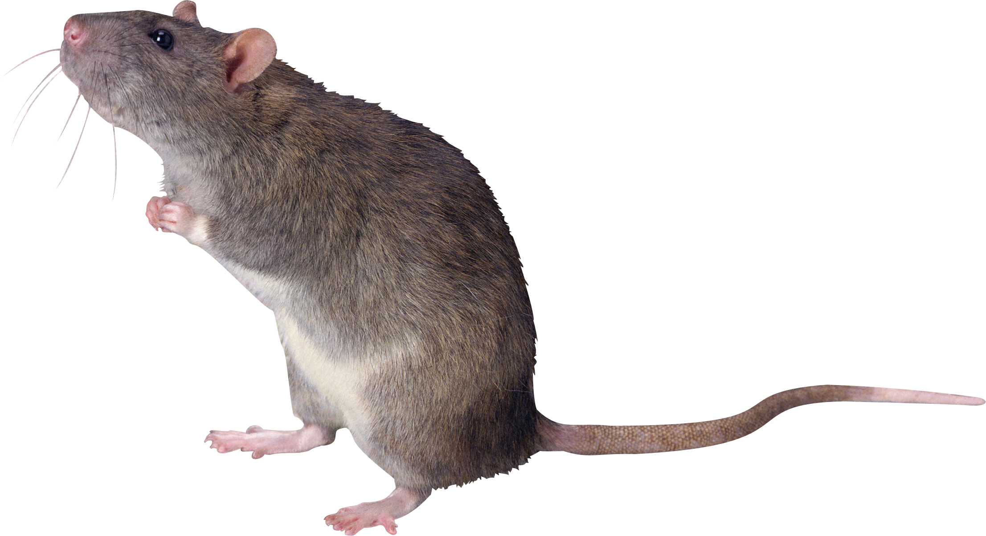
- TPG 2 -
Do Rats Have Downward-Sloping Demand Curves?
Basic Economy for Industrial Engineering
Moin Torabi
Edwin D. Kuttikattil
Nicole Soligo
Luca Campigotto

Slide 2
1. Introduction
The question:
Whether the law of demand applies to animals
How the experiment was conducted:
They confronted each rat with a budget line relating root beer and Collins-mix
They charged a “price” by requiring the rats to press a lever to receive 0.05 mm of each beverage
At an equal price for the root beer and Collin mix, rats preferred the root beer and spent most of their income on it.
Then, the price of Collins-mix was cut in half and the price of roots beer doubled.
The economic theory predicts that consumption of Collins-mix should rise and root beer fall given the new prices.
Was that prediction correct for rats?

Slide 3
1. Introduction
In a similar experiment:
In a similar study the consumption of fluids was restricted to root beer and quinine water.
When they reduced the price of the quinine water, it was observed that rats consumed less quinine at the lower price and used their increased income to increase their root beer consumption.
Why?
Explained by the Giffen good case

Slide 4
2. Economic Topics
Law of Demand
Demand - Amount of goods or service a consumer is willing and able to buy.
Quantity demanded for a good or service rises as the price falls, all other
things being equal.
Substitution effect - change in relative attractiveness of close substitutes.
Income effect - change in real purchasing power.
Price
Quantity
Giffen Good
Exception to law of demand.
Quantity demanded increases when price increases (inferior goods).

Slide 5
3. Case analysis
Quantity
of CM
P_{RB}=1
P_{CM}=1
M=300
Rats have downward-sloping demand curves for root beer (RB) and Collins mix (CM)
RB₁>CM₁
300
CM₁
RB₁
300
Quantity of RB

Slide 6
3. Case analysis
Quantity
of CM
600
P_{RB}=2
P_{CM}=0,5
M=300
Rats have downward-sloping demand curves for root beer (RB) and Collins mix (CM)
CM₂
CM₂>RB₂
CM₂ ≅ 4*CM₁
CM₁
RB₂
RB₁
150
Quantity of RB

Slide 7
3. Case analysis
Quantity
of QW
Quinine water (QW) is a Giffen Good for the rats
P_{QW}
QW₁
S.E.
Income Effect > Substitution Effect.
I.E.
QW₂ < QW₁
QW₂
RB₁
RB₂
Quantity of RB
Notes:
Budget constraint – Demand curve – Consumption curve – basic necessity goods

Slide 8
THANK YOU FOR YOUR ATTENTION

